Slide 1
Architecture Document

Slide 2
Assumptions
You own or can provision an Azure subscription and can create resources (OpenAI/Azure AI, Search, Blob, Cosmos, Purview, Key Vault, Monitor).
Data sources: file shares/Blob, logs (Event Hubs or ingest streams).
Compliance / policy rules exist (or will be codified) as machine-readable rules or mappings (e.g., data classification tags, allowed usage patterns).
“Recommendations” are contextual (e.g., recommend next action: redact, request approval, alternate dataset, ML model to use).

Slide 3
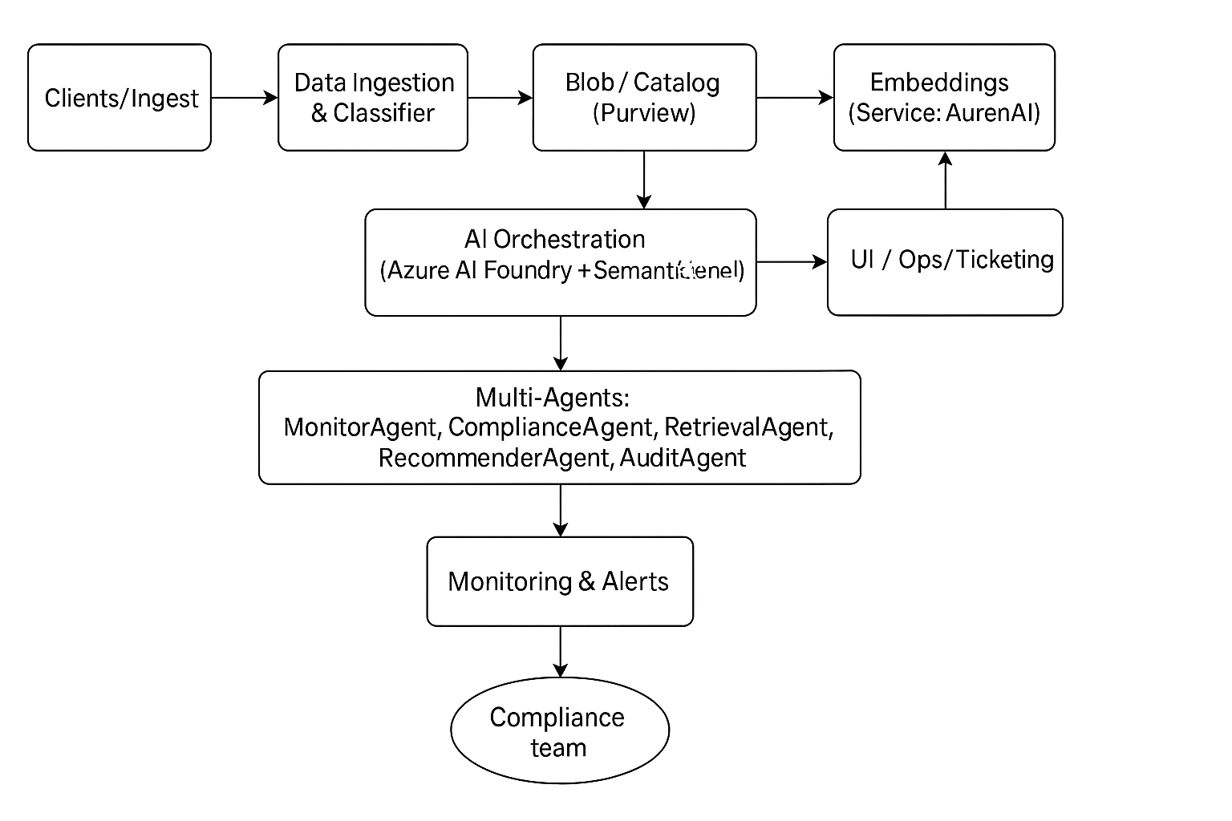
High-level architecture

Slide 4
High-level architecture (one-line diagram)
Clients / Ingest → Data Ingestion & Classifier → Blob / Catalog (Purview) → Index (Azure AI Search vectors) ← Embeddings(Service: Azure OpenAI) AI Orchestration (Azure AI Foundry + Semantic Kernel) → Multi-Agents: MonitorAgent, ComplianceAgent, RetrievalAgent, RecommenderAgent, AuditAgent → UI / Ops / Ticketing Monitoring & Alerts → Azure Monitor / Log Analytics / Logic Apps → Compliance team
(Use Azure AI Foundry / Agent Service to host and orchestrate agents; Semantic Kernel for planner/skills; Azure OpenAI for embeddings / completions; Azure AI Search for vector retrieval; Purview for governance.)

Slide 5
Step-by-step implementation plan
Phase A — Plan, policy & data discovery
Inventory data sources: list files, blobs, SaaS connectors, logs, and who owns each.
Codify policies: convert “allowed/disallowed” usage into rules (example: PII cannot be exported, or sensitive tables require approval). Represent rules as JSON/YAML (rule id, scope, triggers, remediation).
Define success metrics: detection precision/recall for violations, recommendation acceptance rate, false positive rate, mean time to remediate.

Slide 6
Step-by-step implementation plan
Phase B — Provision core Azure resources
Create these principal resources:
Azure AI Foundry / Agent Service workspace. (agent orchestration & tool connectors).
Azure OpenAI (or Azure AI Foundry model endpoints) for embeddings + LLM.
Azure AI Search (Vector Search enabled) for RAG index.
Blob Storage for raw files.

Slide 7
Step-by-step implementation plan
Phase C — Ingest + classify + index (RAG pipeline)
Goal: convert enterprise artifacts into searchable, grounded knowledge with classification metadata.
Ingest raw assets (blobs, DB extracts, logs):
For files: run a pipeline (Azure Function / Data Factory) that downloads, extracts text (excel), and stores raw and parsed text in Blob/Data Lake.
Create embeddings:
Generate embeddings per chunk with Azure OpenAI embeddings. (Use Azure OpenAI embeddings API via the SDK.) Microsoft Learn
Index to Azure AI Search:
Insert each chunk as a document with fields: id, text, source_uri, owner, sensitivity_label, vector_embedding, checksum.
Ensure index schema includes the vector field and classification metadata. Use vector + hybrid for best results.

Slide 8
Step-by-step implementation plan
Phase D — Build Semantic Kernel planner & agent skills
Semantic Kernel: install the SK SDK (Python/.NET) and implement skills:
DiscoverySkill: queries Purview/Catalog for dataset metadata.
PolicySkill: evaluates a request against codified rules; returns allow/deny/require_approval and rationale.
PlanSkill: given a detected usage, suggest remediation sequence (e.g., redact → request approval → anonymize). Use SK planners to produce multi-step plans that call other skills.
Skill design pattern:
Keep skills small and testable. Skills should expect and return structured JSON so Foundry/agents can call them programmatically.

Slide 9
Step-by-step implementation plan
Phase E — Multi-agent design and orchestration (Azure AI Foundry)
Define agents (examples):
MonitorAgent: consumes telemetry (access logs, queries) and detects anomalous patterns (exfil attempts, unusual joins).
ComplianceAgent: evaluates queries/requests against Purview tags + PolicySkill; can block, tag, or escalate.
RetrievalAgent: executes RAG queries against AI Search to ground recommendations.
RecommendationAgent: suggests remediation, safer alternatives, or workflow steps (e.g., anonymize, request approval).
AuditAgent: writes immutable audit records, generates compliance reports, and triggers workflows (Logic Apps/Tickets).
Integrate with Foundry:
Register services (Search, OpenAI, Purview, Cosmos) as tools/connectors.
Define agent flows in Foundry: e.g., MonitorAgent detects event → calls ComplianceAgent → if require_approval then call PlannerSkill to assemble remediation steps → update state + notify.
Tool calling & safety:
Use explicit tool contracts, and place privileged actions (e.g., modify data, release PII) behind escalation gates and user consent checks.

Slide 10
Step-by-step implementation plan
Phase F — Enforcement, remediation & human workflows
Automated actions: for low-risk violations, agents can auto-remediate (apply redaction, quarantine dataset, replace with masked view).
Escalations: for risky actions, agents open tickets (ServiceNow/Teams/Logic Apps) for human approval; include the why card with features used, evidence, and confidence.
Transparent recommendations: always return rationale + confidence + evidence (citations from the RAG results) to the user or reviewer.

Slide 11
Step-by-step implementation plan
Phase G — Observability & operations
Logs & metrics: instrument agents and RAG calls. Send traces and metrics to Application Insights / Azure Monitor. Create alerts for policy violations, high-severity false positives, or model drift.
Dashboards: build Log Analytics / Power BI views for: violation counts, top datasets, response grounding score, remediation time.
Incident playbooks: create runbooks (Logic Apps + playbooks) to perform immediate containment (revoke keys, block IP, disable service principal).

Slide 12
Step-by-step implementation plan
Phase H — Responsible AI, testing & audits
Safety checks: use Azure AI Content Safety for any user-facing LLM outputs and for any content being recommended that could contain sensitive data.
Data governance: use Purview to maintain catalog, sensitivity labels, and lineage so agents can make decisions based on authoritative metadata.
Evaluation suite:
Grounding tests: sample queries should return <X% hallucination (define threshold).
Bias/fairness checks: ensure recommendations don’t disproportionately block/surface data for certain groups.
Red team: adversarial prompts to find bypasses and evasion vectors.
Recordkeeping: store model versions, prompt templates, evaluation runs, and the audit trail for regulatory compliance.

